Slide 1
LOGIC DESIGN OF
SEQUENTIAL CIRCUITS
General Model of Sequential Circuit
Flip-Flop as Basic Memory Unit
Analysis of Sequential Circuits
Design of Sequential Circuits
Sequential MSI Modules

Slide 2
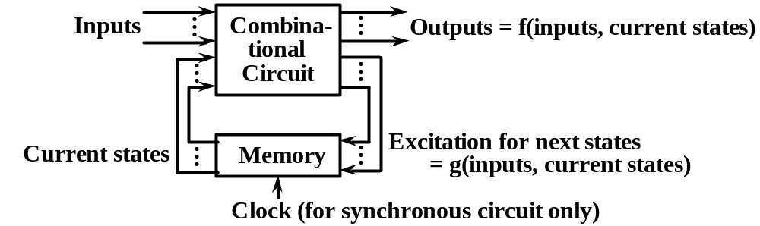
General Model of Sequential Circuit
Output depends on circuit’s history stored as state
variables in memory.
Mealy machine: outputs = f(inputs,current states)
Moore machine: outputs = f(current states)
It has no input variables other than the clock.
Excitation signals act on memory for next states.
Synchronous circuit — State changes only at the
occurrence of clock.
Asynchronous circuit — State changes in response
to the change of inputs.

Slide 3
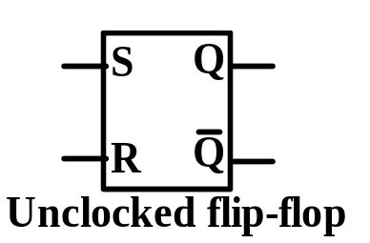
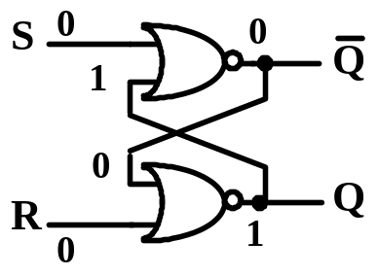
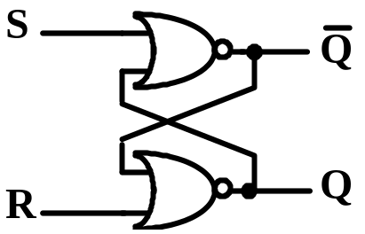
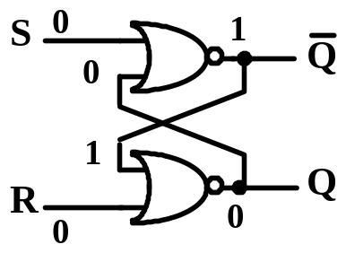
FLIP-FLOP AS
BASIC MEMORY UNIT
A simple SR Latch with two stable states:
Q=0, Q=1 in ‘0’ state; Q=1,Q=0 in ‘1’ state.
S(set), R(reset) — excitation signals.
Conceptual circuit:
symbol, state transition table
->1
S R 0 0
0 0 0 1 0 1 1 0 1 0 1 1 1 1
Q(t) 0 1 0 1 0 1 0
1
Q(t+1) 0 1 0 0 1 1
not defined
not defined
->0
} Q(t+1)=Q(t)
->1
->1
->0
} Q(t+1)=0
->1
->0
} Q(t+1)=1
->1
->0
->1

Slide 4
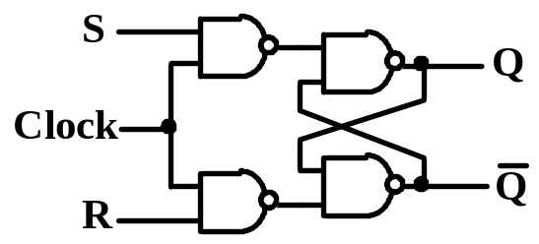
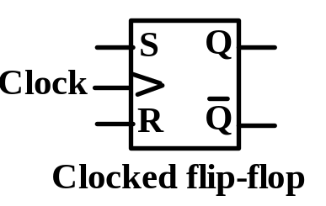
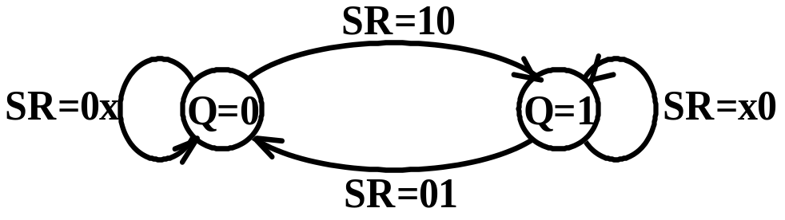
BASIC MEMORY UNIT: FLIP-FLOP
Clocked SR flip-flop
Flip-flop changes state only when clock = 1.
Conceptual ckt, symbol, state transition table
& equation:
S R 0 0
0 0 0 1 0 1 1 0 1 0 1 1 1 1
Q(t) 0 1 0 1 0 1 0
1
Q(t+1)
0
1
0
0
1
1
not defined
not defined
} Q(t+1)=Q(t)
} Q(t+1)=0
} Q(t+1)=1
Q(t+1) = S+RQ(t)
SR = 0 (restriction)
State transition diagram & excitation table:
Q(t)
0
0
1
1
Q(t+1)
0
1
0
1
S R 0 x
1 0 0 1 x 0

Slide 5
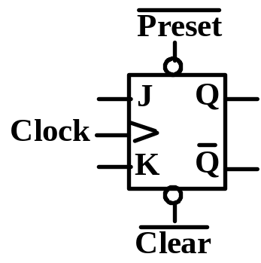
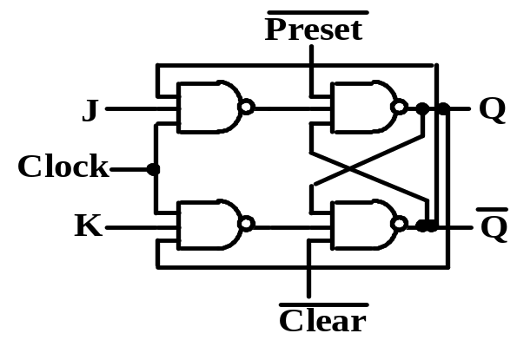
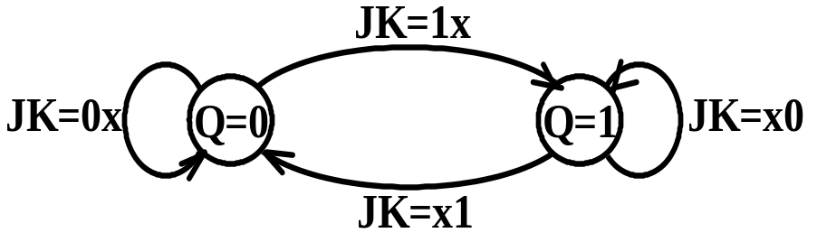
Clocked JK flip-flop
Extension of SR FF by allowing J=1 & K=1.
Conceptual ckt, symbol, state transition table & equation:
J K 0 0
0 0 0 1 0 1 1 0 1 0 1 1 1 1
Q(t) 0 1 0 1 0 1 0
1
Q(t+1)
0
1
0
0
1
1
1
0
} Q(t+1)=Q(t)
} Q(t+1)=0
} Q(t+1)=1
} Q(t+1)=Q(t)
Q(t+1) = JQ(t)+KQ(t)
State transition diagram & excitation table:
Q(t) 0 0 1 1
Q(t+1) 0 1 0 1
J K 0 x
1 x x 1 x 0

Slide 6
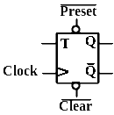
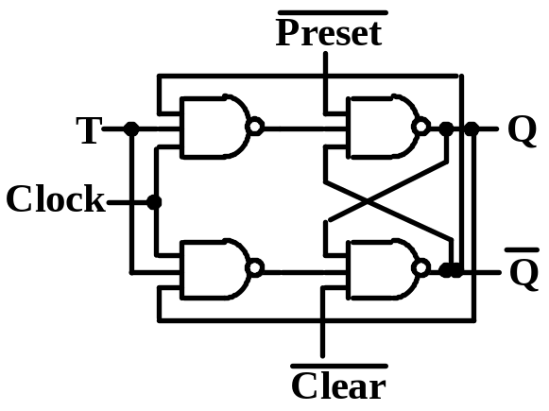
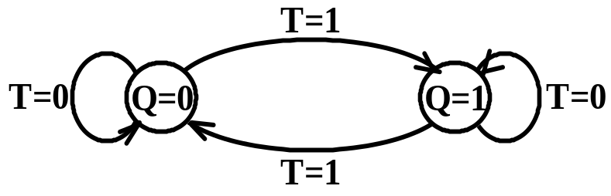
Clocked T flip-flop
A special case of JK FF by setting J=K=T.
Conceptual ckt, symbol, state transition table & equation:
T 0
0 1 1
Q(t) 0 1 0 1
Q(t+1) 0
1 1 0
} Q(t+1)=Q(t)
} Q(t+1)=Q(t)
Q(t+1) = TQ(t)+TQ(t)=T + Q(t)
State transition diagram & excitation table:
Q(t) 0 0 1 1
Q(t+1) 0 1 0
1
T 0
1 1 0

Slide 7
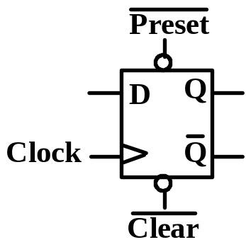
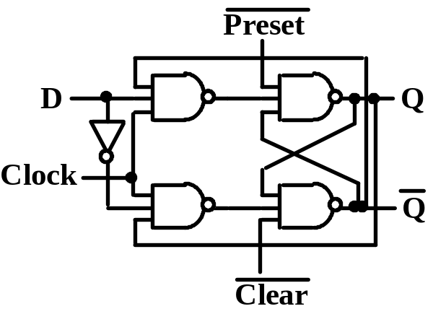
Clocked D flip-flop
A special case of JK FF by setting J=K=D.
Conceptual ckt, symbol, state transition table & equation
D 0
0 1 1
Q(t) 0 1 0 1
Q(t+1) 0
0 1 1
} Q(t+1)=D
Q(t+1) = D
State transition diagram & excitation table:
D=1
Q(t) 0
0
1
1
Q(t+1) 0 1 0 1
D0
1 0 1
D=0
Q=0
Q=1
D=1
D=0

Slide 8
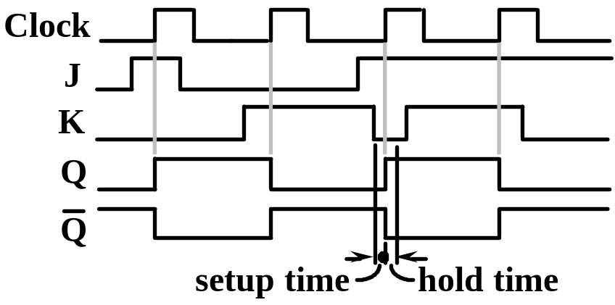
FLIP-FLOP AS BASIC MEMORY UNIT
Edge-triggered flip-flop
FF changes state only at the edge of the clock.
Solves the problem of multiple triggering of
level-controlled FF when level is active.
Two methods of circuit implementation:
◊ master-slave flip-flop
◊ special circuit
Typical waveforms of edge-triggered JK FF:
In the setup time, J,K must
be constant prior to the
active edge of the clock.
In the hold time, J,K must
not change after the
active edge of the clock.

Slide 9
FLIP-FLOP AS BASIC MEMORY UNIT
Master-Slave flip-flop
Master FF can change state only by CP = 1,
just like a level-controlled FF.
Slave FF is driven by master FF by CP=1,
independent of any changes of J and K.
Analysis of
the circuit
see Figure
4.18.
J
P
Q
CP
CP
P
K
Q
The master-slave
FF acts like a
negative edge- triggered FF.
CP
J
K
P
Q

Slide 10
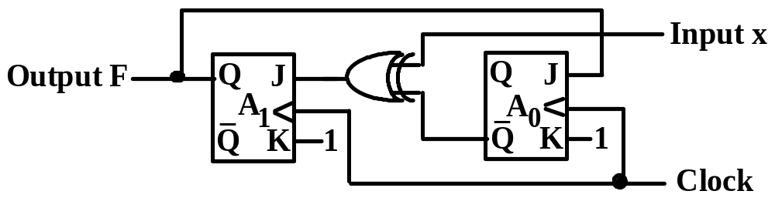
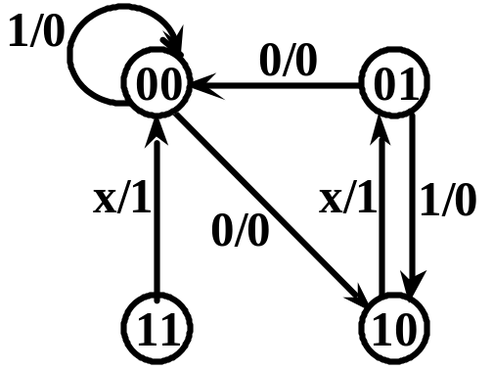
ANALYSIS OF SEQUENTIAL CIRCUITS
Write logical expressions for excitation and
output in terms of input and current state.
Write state transition table and output table.
Draw the state transition diagram.
Example 4.1
J₁ = x + A₀
K₁ = 1
J₀ = A₁
K₀ = 1
F = A₁
current
next
x
0 0 0 01 1 1 1
A₁ A₀
0 0 0 1 1 0 1 1 0 0 0 1 1 0 1 1
J₁ K₁
1 1 0 1 1 1 0 1 0 1 1 1 0 1 1 1
J₀ K₀
0 1 0 1 1 1 1 1 0 1 0 1 1 1 1 1
A₁’
1 0 0 0 0 1 0 0
A₀’
0 0 1 0 0 0 1 0
F
0 0 1 10 0 1 1
When x=0,
00->10->01->00->…
When x=1,
01->10->01->…
Self-correcting:
x=0, 11->00
x=1, 11->00, 00->00

Slide 11
DESIGN OF SEQUENTIAL CIRCUITS
Design of a Gray Code Counter (Example 4.2)
Problem specification.
For the counter, find state transition table.
Excitation table for the type of chosen FF.
Simplest expressions of excitation signals.
Check the self-correcting property. If not
correct, modify the design.
Implement the counter, then the system.
Example
Design a counter for the given
Gray code subsequence:
000 001 011 010 110 100 000(repeat)

Slide 12
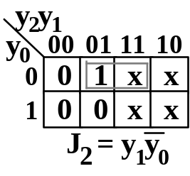
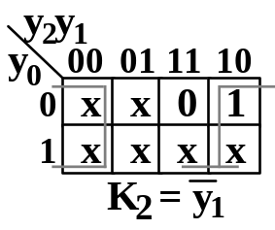
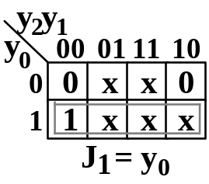
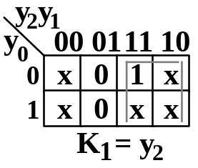
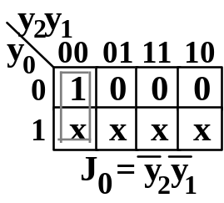
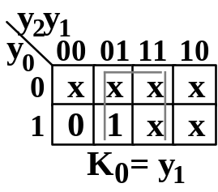
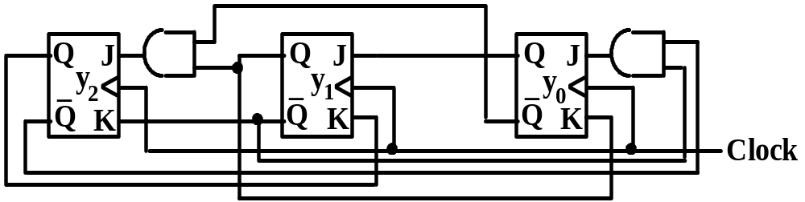
DESIGN OF SEQUENTIAL CIRCUITS (continued)
Design of the counter using JK FF’s
Counting sequence state transition table
State transition table Excitation table
current
next
Excitation for JK FF’s
y₂ y₁ y₀
0 0 0 0 0 1 0 1 0 0 1 1 1 0 0 1 0 1 1 1 0 1 1 1
y₂’ y₁’ y₀’
0 0 1 0 1 1 1 1 0 0 1 0 0 0 0 x x x 1 0 0 x x x
J₂ K₂
0 x 0 x 1 x 0 x x 1 x x x 0 x x
J₁ K₁
0 x 1 x x 0 x 0 0 x x x x 1 x x
J₀ K₀
1 x x 0 0 x x 1 0 x x x 0 x x x
Self-correcting:
101 ->011
111 -> 100

Slide 13
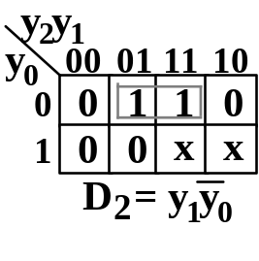
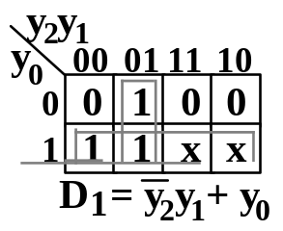
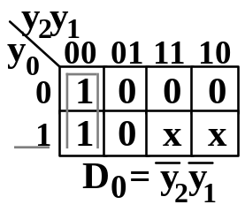
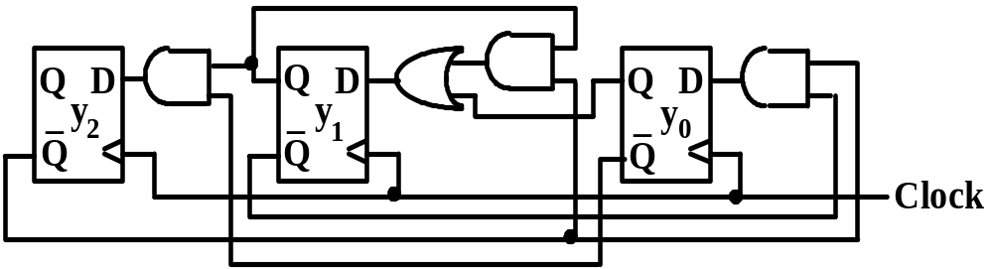
DESIGN OF SEQUENTIAL CIRCUITS (continued)
Design of the counter using D FF’s
State transition table & Excitation table
current
next
Excitation
y₂ y₁ y₀
0 0 0 0 0 1 0 1 0 0 1 1 1 0 0 1 0 1 1 1 0 1 1 1
y₂’ y₁’ y₀’
0 0 1 0 1 1 1 1 0 0 1 0 0 0 0 x x x 1 0 0 x x x
D₂ D₁ D₀
0 0 1 0 1 1 1 1 0 0 1 0 0 0 0 x x x 1 0 0 x x x
Self-correcting:
101 -> 010
111 -> 010

Slide 14


SEQUENTIAL MSI MODULES
Shift Register & Shift Operations
Left shift, e.g., on JK FF’s
Logical right shift, e.g., on D FF’s
Arithmetic right shift: connect MSB to shift in
Arithmetic left shift: signal overflow if the
sign changes.
Rotate: connect shift in & shift out

Slide 15
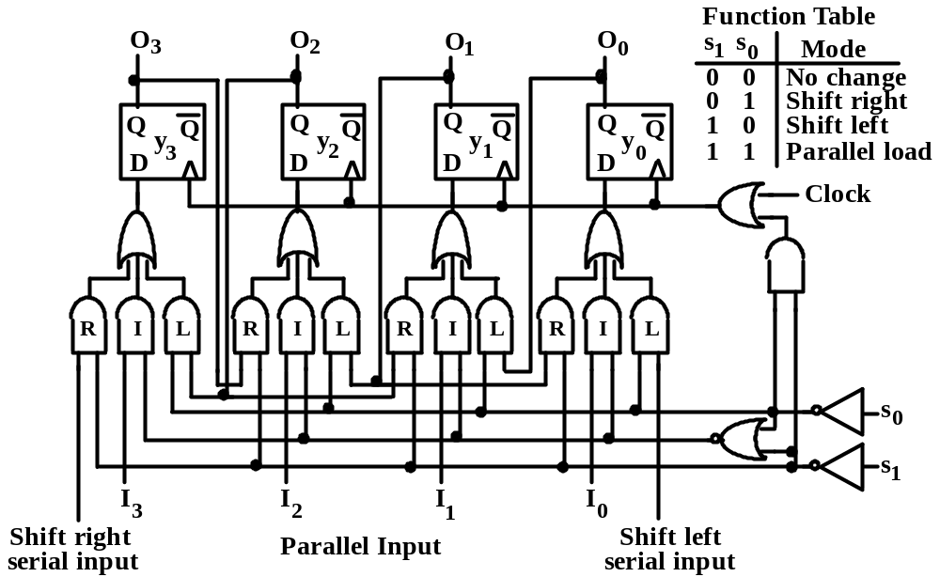
SEQUENTIAL MSI MODULES(continued)
Bidirectional Shift Register
To maintain D FF unaltered, either feedback
Q to D or block the clock.
Use AND or OR gate to block the clock.

Slide 16
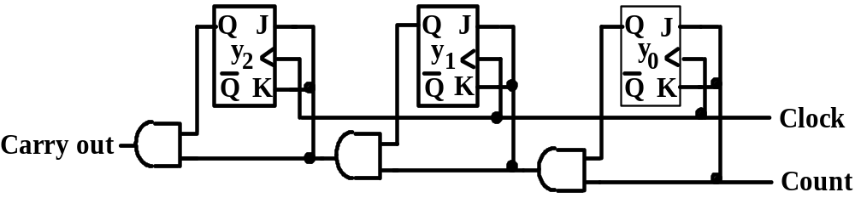
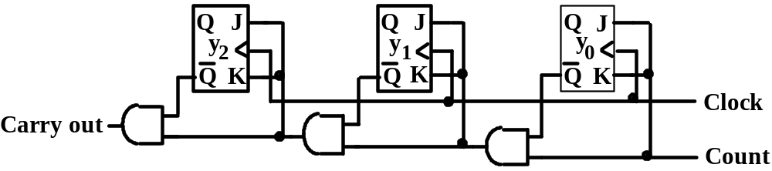
SEQUENTIAL MSI MODULES(continued)
Ripple-Carry Binary Counter
Count up
Count down
Count up
current
next
next
y₀ triggers every clock.
y₁ triggers if y₀=1.
y₂ triggers if y₁y₀=1.
y_{i} triggers if y_{i-1}…y₀=1.
y₂ y₁ y₀
0 0 0 0 0 1 0 1 0 0 1 1 1 0 0 1 0 1 1 1 0 1 1 1
y₂’ y₁’ y₀’
0 0 1 0 1 0 0 1 1 1 0 0 1 0 1 1 1 0 1 1 1 0 0 0
y₂’ y₁’ y₀’
1 1 1 0 0 0 0 0 1 0 1 0 0 1 1 1 0 0 1 0 1 1 1 0
Count down
y₀ triggers every clock.
y₁ triggers if y₀=1.
y₂ triggers if y₁y₀=1.
y_{i} triggers if y_{i-1}…y₀=1.

Slide 17
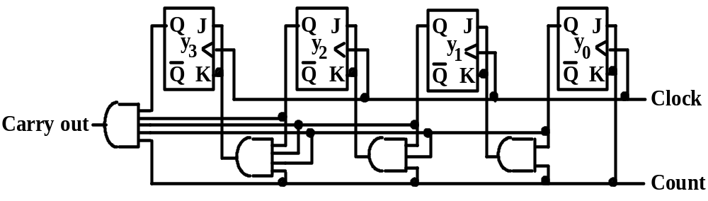
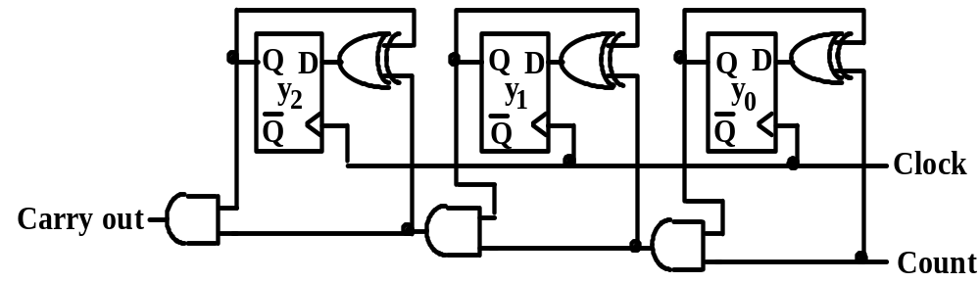
SEQUENTIAL MSI MODULES(continued)
Counter on D FF’s & Parallel Counter
Parallel Counter
Counter on D FF’s

Slide 18
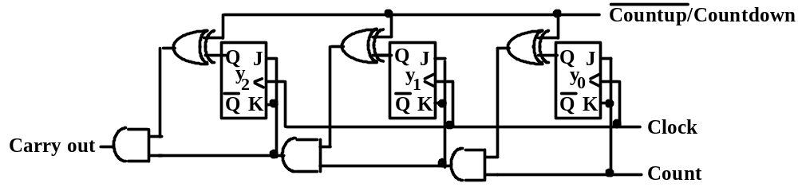
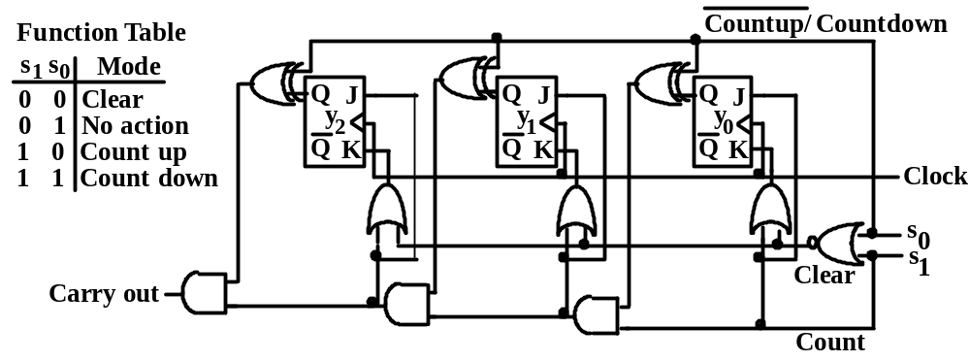
SEQUENTIAL MSI MODULES(continued)
Up/Down Counter
Up/Down Counter selected by XOR gates
Multifunctional Up/Down Counter

